Slide 1

Natural Language Processing
Rohit Kate
Linguistics Essentials – Part 2
Reading: Chapter 3, Textbook 2

Slide 2
Subcategorization
All verbs constrain their arguments via subcategorization
Different verbs have different patterns of arguments:
Sneeze: John sneezed
Takes only one argument (subject)
Incorrect usage for other verbs: *John found *John gave
Find: Please find [a flight to NY]_{NP}
Takes only one argument (noun phrase)
Give: Give [me]_{NP}[a cheaper fare]_{NP}
Takes two arguments argument (two noun phrases)
Help: Can you help [me]_{NP}[with a flight]_{PP}
Takes two arguments argument (two noun phrases)
Prefer: I prefer [to leave earlier]_{TO-VP}
Takes only one argument (to-verb phrase)
Said: You said [United has a flight]_{S}
Takes only one argument (sentence clause)

Slide 3
NLP Task: Semantic Role Labeling
For a verb, determine the arguments or the semantic roles played by various noun phrases; this helps in analyzing the sentence
sender
recipient
Show the long email Alice sent me yesterday
theme

Slide 4
Lexical dependency
In addition to constituency and subcategorization, there are functional relations (“lexical dependencies”) between pairs of words
For example, subject and object are two types of binary relations for verbs
The next slide lists several other dependency types
The dependencies form a type of tree structure on words

Slide 5
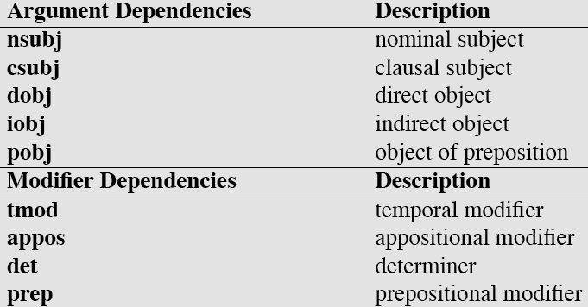
Common Dependency Relations
Adapted from Susan McRoy’s slide.

Slide 6
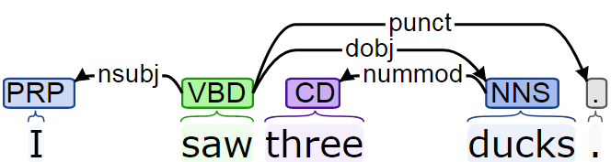
Example Dependency tree
Adapted from Susan McRoy’s slide.

Slide 7
Syntax
There are potentially infinite sentences in a language, is there some structure behind them?
A basic question in Linguistics: What forms a legal sentence in a language?
Syntax helps to answer that question
Syntax is the study of word orders and phrase structures
Syntactic analysis tells how to determine meaning of a sentence from the meaning its of words
The dog bit the man.
The man bit the dog.
Colorless green ideas sleep furiously.
A famous sentence which is meaningless but grammatical, indicating distinction between syntax and semantics

Slide 8
Phrase Structure Grammars
Linguists have come up with many grammar formalisms to capture syntax of languages, phrase structure grammar is one of them and is very commonly used
Other formalisms
Combinatory categorial grammar
Tree adjoining grammar
A context-free grammar (CFG) that generates sentences

Slide 9
Context Free Grammars (CFG)
N a set of non-terminal symbols
Σ a set of terminal symbols (disjoint from N)
R a set of productions or rules of the form A→β, where A is a non-terminal and β is a string of symbols from (Σ∪ N)*
Context free: Only one symbol on the left side of a production
S, a designated non-terminal called the start symbol
Notes:
9

Slide 10
Phrase Structure Grammars
Productions of a small example grammar:
S → NP VP
VP → Verb
VP → Verb NP
NP → Article Noun
Verb → [slept|ate|made|bit]
Noun → [girl|cake|dog|man]
Article → [A|The]

Slide 11
Phrase Structure Grammars
Non-terminals
S
NP
VP
Article
Noun
Verb
NP
The
girl
ate
Article
Noun
Terminals
the
cake
A syntactic derivation or a parse tree
The parse of the sentence is typically shown as a tree
The girl ate the cake.

Slide 12
Noun Phrases (NP)
NP → Pronoun
I came, you saw it, they conquered
NP → Proper-Noun
Los Angeles is west of Texas
Mark is the Chancellor of UWM
NP → Det Noun
The Chancellor
NP → Det Adj* Noun
The book; the big book; the big, red book
NP → Det Nominal
Nominal → Noun Noun PP
morning flight to Milwaukee
Adapted from Susan McRoy’s slide.
12
Notes:
12

Slide 13
Prepositional Phrases (PP)
PP ⟶ Preposition NP
From Chicago
To Milwaukee
On Tuesday
After lunch
In the middle of a pandemic
Adapted from Susan McRoy’s slide.
13
Notes:
13

Slide 14
Sentence Types
Declaratives: A plane left.
S ⟶ NP VP
Imperatives: Leave!
S ⟶ VP
Yes-No Questions: Did the plane leave?
S ⟶ Aux NP VP
WH Questions:
S ⟶ WH-word Aux NP VP When did the plane leave?
S ⟶ WH-NP VP Who ate my sandwich?
Adapted from Susan McRoy’s slide.
14
Notes:
14

Slide 15
Coordinating Constructions
S → S and S
John went to NY and Mary followed him
NP → NP and NP
VP → VP and VP
…
In fact the right rule for English is (more or less):
X → X and X
We use “clause” to describe a sentence that occurs within another sentence.
Adapted from Susan McRoy’s slide.
15
Notes:
15

Slide 16
Phrase Structure Grammars
Some of the productions can be recursive (one inside another, like NP → NP PP) which can then expand several times (the following is another way to represent a parse tree using bracketing)
(S
(NP (PRP I))
(VP
(VBD saw)
(NP (NP (DT the) (NN man))
(PP (IN on) (NP (NP (DT the) (NN hill))
(PP (IN with)
(NP (DT the) (NN telescope))))))))
Because of recursion in the grammars there are potentially infinite number of sentences in a language

Slide 17
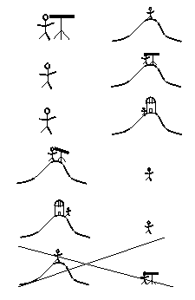
Syntactic Ambiguity
Typically a grammar can lead to several parses of a sentence, called syntactic ambiguity
(S
(NP (PRP I))
(VP
(VBD saw)
(NP (NP (DT the) (NN man))
(PP (IN on) (NP (NP (DT the) (NN hill))
(PP (IN with)
(NP (DT the) (NN telescope))))))))
PP “with the telescope” is attached to the NP “the hill”
PP “on the hill…” is attached to the NP “the man”

Slide 18
Syntactic Ambiguity
Typically a grammar can lead to several parses of a sentence, called syntactic ambiguity
(S
(NP (PRP I))
(VP
(VBD saw)
(NP (NP (DT the) (NN man))
(PP (IN on) (NP (DT the) (NN hill))))
(PP (IN with) (NP (DT the) (NN telescope)))))
PP “on the hill” is attached to the NP “the man”
PP “with the telescope” is attached to the verb “saw”

Slide 19
Syntactic Ambiguity
Typically a grammar can lead to several parses of a sentence, called syntactic ambiguity
(S
(NP (PRP I))
(VP
(VBD saw)
(NP (NP (DT the) (NN man))
(PP (IN on) (NP (DT the) (NN hill))
(PP (IN with) (NP (DT the) (NN telescope))))))
PP “on the hill” is attached to the NP “the man”
PP “with the telescope” is attached to the NP “the man”

Slide 20
Syntactic Ambiguity
Typically a grammar can lead to several parses of a sentence, called syntactic ambiguity
(S
(NP (PRP I))
(VP
(VBD saw)
(NP (DT the) (NN man))
(PP (IN on) (NP (DT the) (NN hill)))
(PP (IN with) (NP (DT the) (NN telescope)))))
PP “on the hill” is attached to the verb “saw”
PP “with the telescope” is attached to the verb “saw”

Slide 21
Syntactic Ambiguity
Typically a grammar can lead to several parses of a sentence, called syntactic ambiguity
(S
(NP (PRP I))
(VP
(VBD saw)
(NP (DT the) (NN man))
(PP (IN on) (NP (DT the) (NN hill))
(PP (IN with) (NP (DT the)
(NN telescope))))))
PP “on the hill” is attached to the verb “saw”
PP “with the telescope” is attached to the NP “the hill”
Note that the last possibility cannot be interpreted from the sentence.

Slide 22
NLP Task: Syntactic Parsing
Not uncommon to have hundreds of parses for a sentence
Syntactic parsing is the task of finding the best parse for a sentence
Previous rule-based approaches were brittle and would not work well
Statistical and deep learning methods for syntactic parsing have been more successful and are currently used

Slide 23
Linguistic Resources for NLP: Corpora
A large collection of text is called a corpus, plural is corpora
Useful for studying a language (corpus linguistics) as well as for NLP (extracting information about words, syntax etc.)
Often a corpus is manually annotated with linguistic information (e.g. syntactic parses, dependency parses, correct senses of words, etc.)
Serves as data to train and evaluate machine learning systems for NLP
There are several corpora available including many annotated ones

Slide 24
Brown Corpus
First “large collection” of text, created at Brown University in the 60s
500 samples of English text, around 1 million words, from a wide variety of text (press, periodicals, science, fiction etc.)
Was annotated with POS tags semi-automatically (automated followed by hand corrections)

Slide 25
Penn Treebank
Very widely used resource in NLP
Created in the 90s at Univ of Pennsylvania
Text data of three years of Wall Street Journal (WSJ) news stories
98,732 news stories, 1.2 million words
Around 40,000 sentences from a subset of stories were manually annotated by linguists with syntactic parses
Used for training machine learning methods
Additional 2,416 sentences are used for evaluating
The POS tags we saw last time were from this corpus
Later also included data from Switchboard corpus of phone conversations
https://catalog.ldc.upenn.edu/LDC99T42

Slide 26
First Sentence from Penn Treebank
( (S
(NP-SBJ
(NP (NNP Pierre) (NNP Vinken) )
(, ,)
(ADJP
(NP (CD 61) (NNS years) )
(JJ old) )
(, ,) )
(VP (MD will)
(VP (VB join)
(NP (DT the) (NN board) )
(PP-CLR (IN as)
(NP (DT a) (JJ nonexecutive) (NN director) ))
(NP-TMP (NNP Nov.) (CD 29) )))
(. .) ))
26
Notes:
26

Slide 27
Web Treebank
Sentences on the web are different from sentences in news story (informal, noisy etc.)
A parser trained on Penn Treebank may not work well on parsing sentences from the web
Completed in 2012 , Contains 16,624 sentences (254,830 words) annotated with POS tags, syntactic parses and dependency parses
Web text of five types
blog posts, newsgroup threads, emails, product reviews, and answers from question-answer websites
https://catalog.ldc.upenn.edu/LDC2012T13

Slide 28
PropBank
Project at U Penn to add semantic roles to the Penn treebank.
Roles (Arg0 to ArgN) specific to each individual verb to avoid having to agree on a universal set.
Arg0 basically “agent”, Arg1 basically “patient”, etc.
Annotated over 1M words of Wall Street Journal text with existing gold-standard parse trees.
Statistics:
43,594 sentences 99,265 propositions (verbs + roles)
3,324 unique verbs 262,281 role assignments
https://propbank.github.io/
Arg0
Arg1
Show the long email Alice sent me yesterday
Arg3

Slide 29
OntoNotes
Collection of 2.9 million word text across three languages: Arabic, Chinese, English
Completed in 2013, incudes a variety of sources (news, conversational telephone speech, weblogs, usenet newsgroups, broadcast, talk shows)
Besides syntactic parse trees, includes semantic role labeling information, word senses and coreferences
https://catalog.ldc.upenn.edu/LDC2013T19

Slide 30
Open American National Corpus (OANC)
15 million words
Automatically annotated for a variety of linguistic structures, also a portion manually annotated/validated
Variety of genres, including transcribed spoken data
https://www.anc.org/

Slide 31
Universal Dependencies
Ongoing international collaborative project
Consistent annotation of grammar (morphological features, POS tags, dependencies) across 100+ languages
So far around 200 treebanks
https://universaldependencies.org/

Slide 32
Many More Corpora
There are many more corpora
Annotated
Unannotated
Other languages
Parallel
sentence-by-sentence in more than 1 language
Domain-specific: clinical text, biomedical articles, etc.

